Slide 1


Slide 2
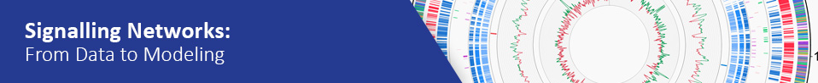

Welcome to
@GenomeAnalysis

Slide 3

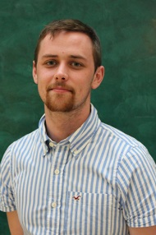
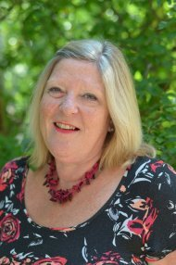
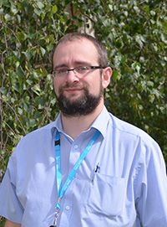
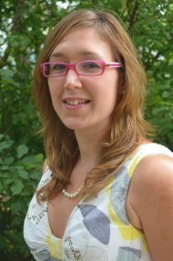
TGAC Training Team
@GenomeAnalysis

Slide 4
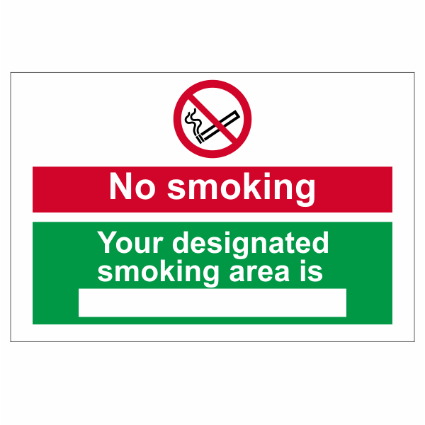



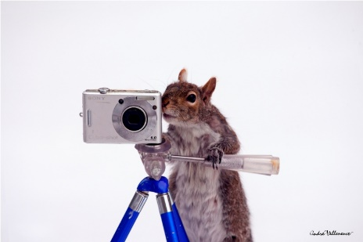
The boring stuff…
Smoking areas
Fire emergency
Feeling unwell?
Emailing and Tweeting
Photos
@GenomeAnalysis

Slide 5
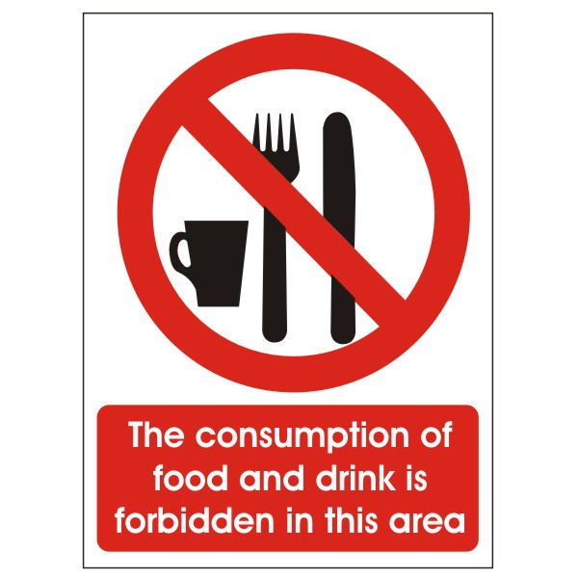

Training Room Rules…
Only joking!
Except water in the bottles provided
@GenomeAnalysis

Slide 6
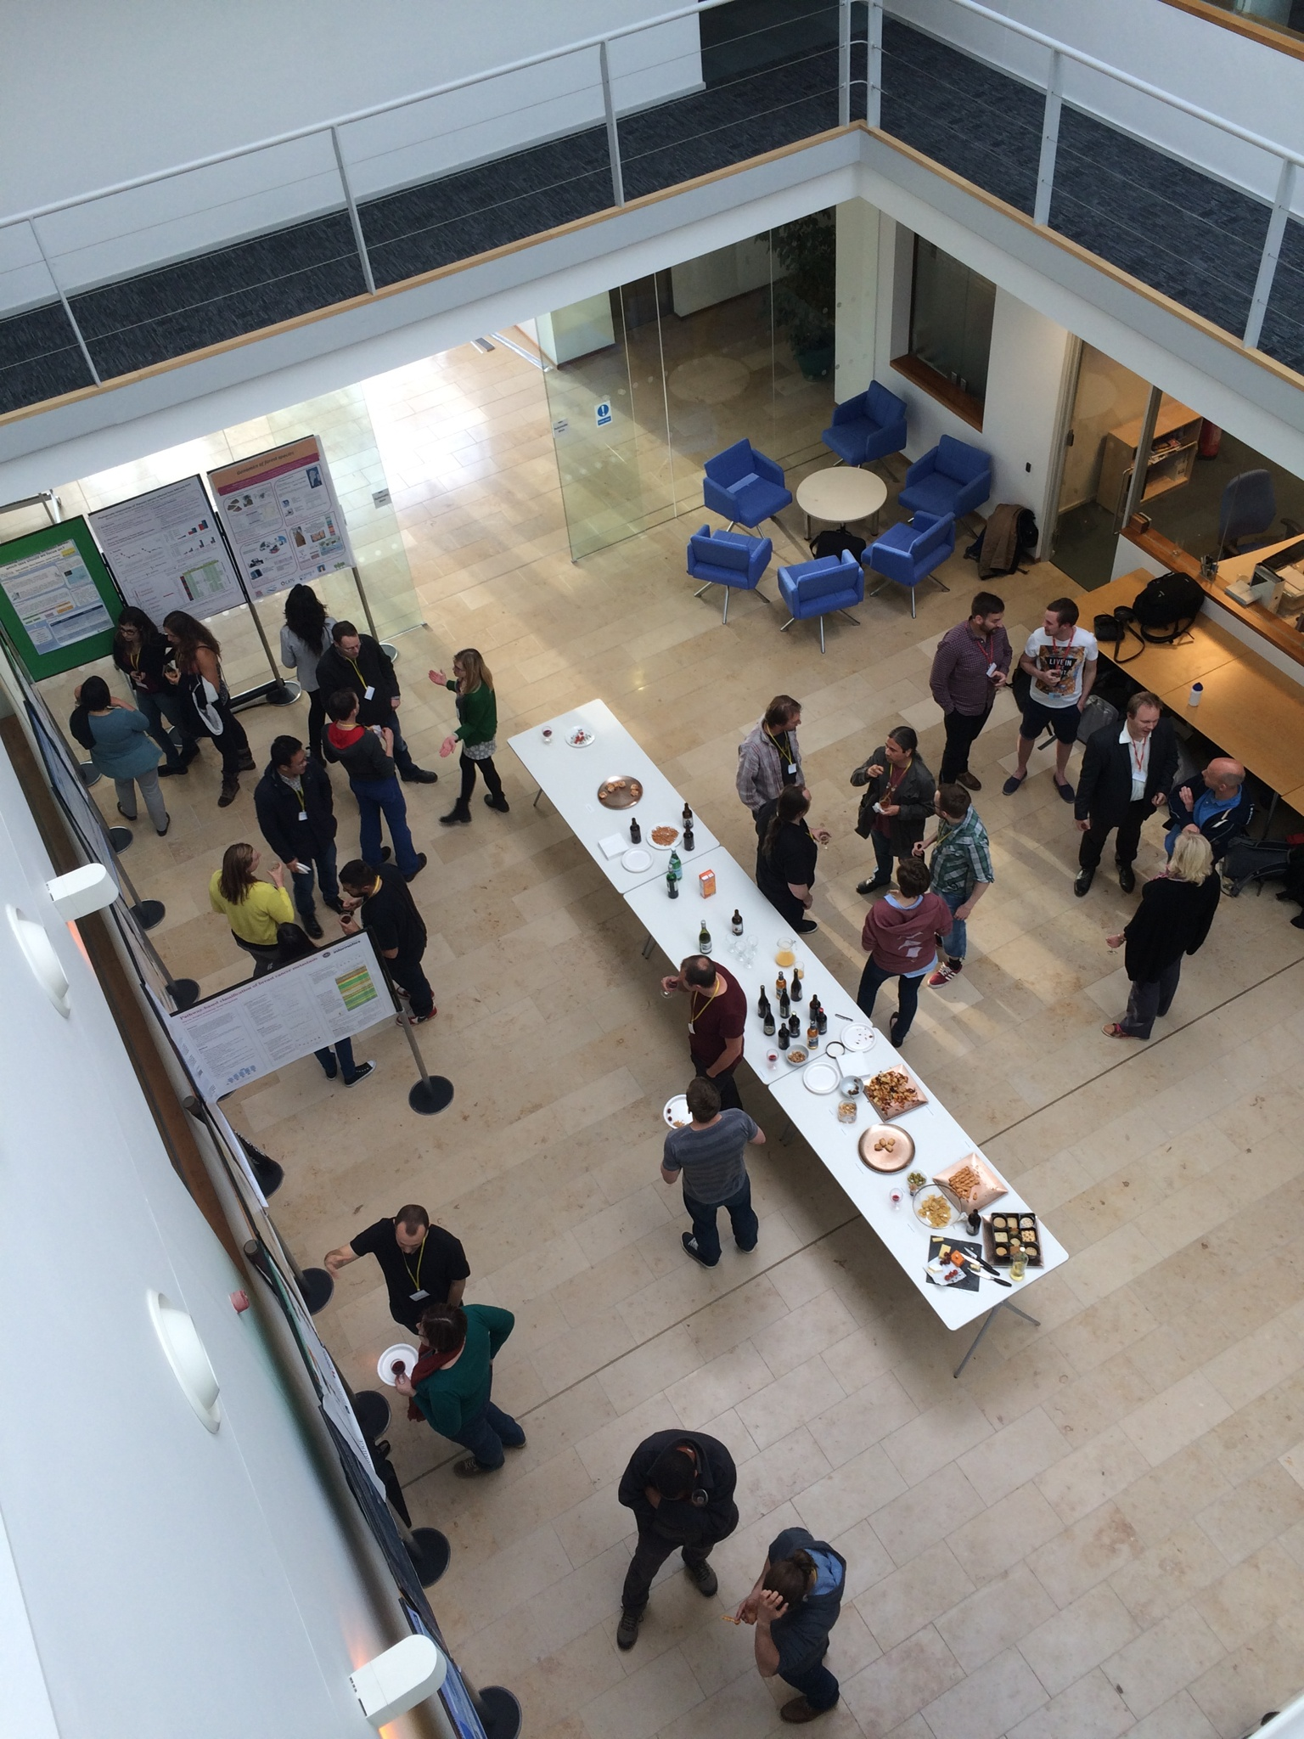
Catering…
At TGAC downstairs atrium!
Course Dinner – Thursday!
@GenomeAnalysis

Slide 7
Any questions???
@GenomeAnalysis

Slide 8

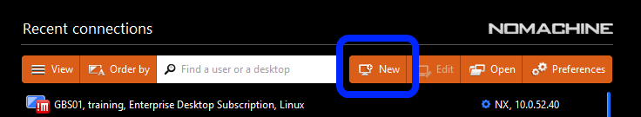
Connecting to NoMachine
After starting the program click “New” on the top bar

Slide 9

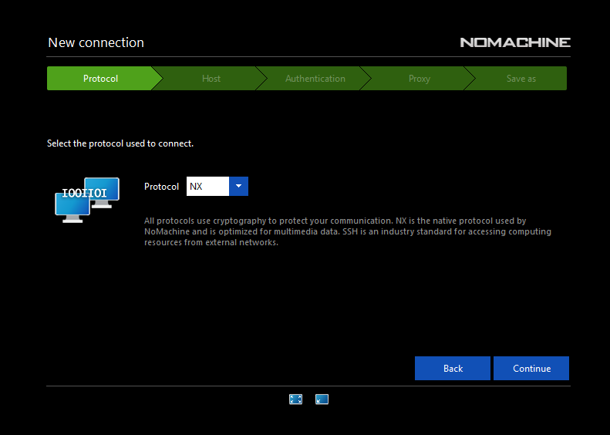
Connecting to NoMachine
Leave this screen as it is.

Slide 10
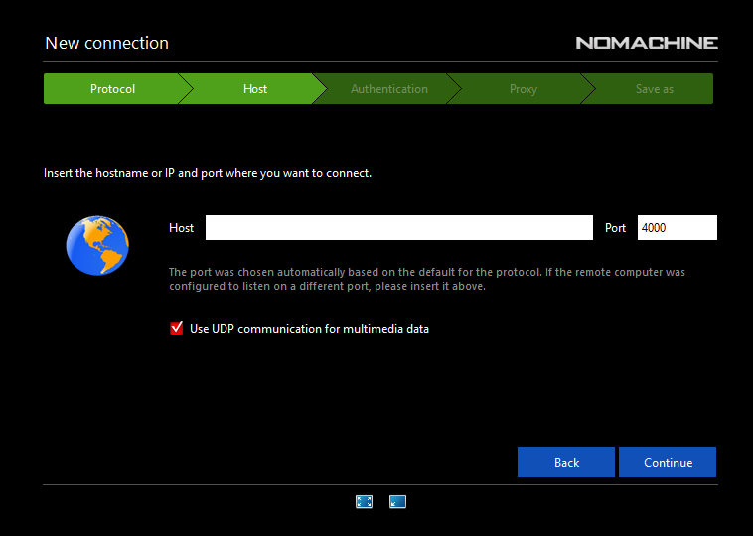
Connecting to NoMachine
Fill in the IP Address found on your paperwork, leaving the port at 4000

Slide 11
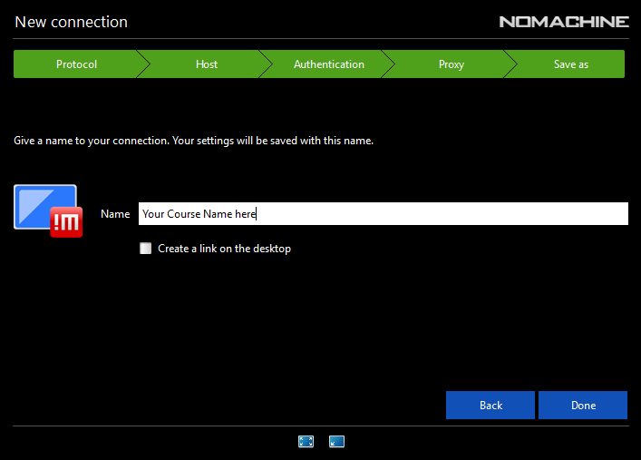
Connecting to NoMachine
Press “Next” twice leaving the settings as they are to get to this screen. Give your connection a name and hit “Done”

Slide 12
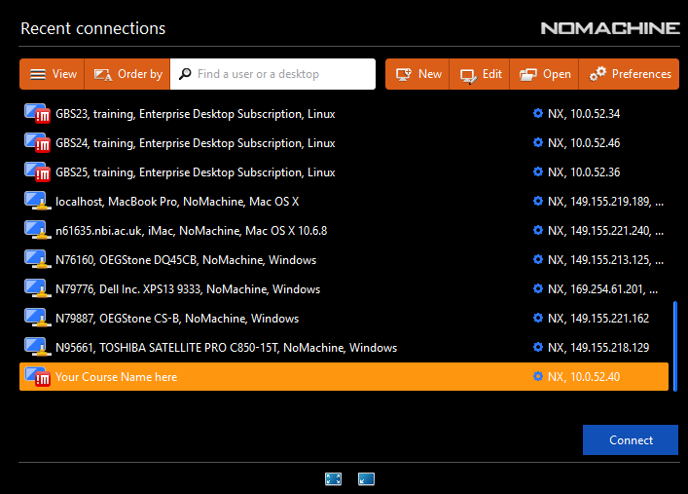
Connecting to NoMachine
Select your course from the list and select “Connect”

Slide 13
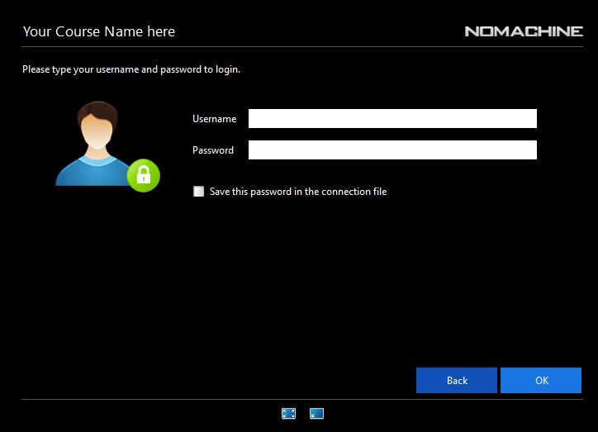
Connecting to NoMachine
Fill in the Username and Password given on your paperwork and click the “Save this password option” then click “ok”

Slide 14
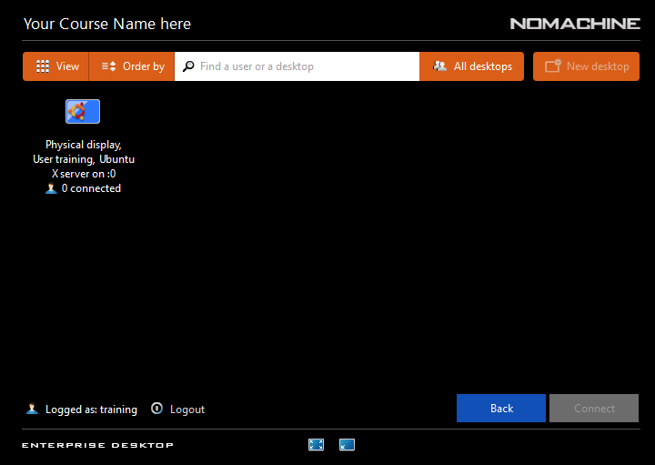
Connecting to NoMachine
You should be presented with a screen like this, Click on the “Physical Display” then “Connect”

Slide 15
Connecting to NoMachine
You should then be presented with a short tutorial on how to use NoMachine and edit visual and sound settings.

Slide 16
Connecting to NoMachine
Final Thoughts
Do NOT turn off your machine, simply close the program.
Pressing “Ctrl+Alt” will cause the mouse to pop out of the application enabling you to interact with your native Operating System and programs.
Changing the Keyboard layout is done by clicking on the cog on the top right of the screen, selecting “System Settings” the “Text Entry” use the “+” icon and select a language/layout. You can then use the “-” icon to remove unwanted language/layouts

Slide 17
Amal Aldarwesh Ph.D Student in Pharmaceutical Cell biology, School of Pharmacy, UEA Lecturer of Pharmacology, King Saud University

Slide 18
Education
PhD student at University of East Anglia (UEA), School of Pharmacy, Department of Pharmaceutical Cell Biology, Norwich, UK (March 2012- March 2016).
Master’s Degree in Bioethics Program, King Abdullah International Medical Research Centre at King Saud bin Abdulaziz University for Health Science (March 2010-October 2012).
Master’s Degree of Pharmacology, College of Pharmacy, King Saud University (June 2009).
Bachelor Degree of Pharmaceutical Sciences (B.Pharm.), College of Pharmacy, King Saud University (February 2005).

Slide 19
My current research
Molecular mechanisms underlying visual field loss in glaucoma. A central theme is the oxygen and glucose deprivation mechanisms.

Slide 20
Previous research
Mechanisms underlying cardiotoxicity and nephrotoxicity of anticancer agents in carnitine depleted animals.

Slide 21
Why I’m here
Currently participating in a research project about Myotonic dystrophy investigating the interferon regulated genes using gene array analysis

Slide 22


Laura Barrio Cano Post-doc Dynamics of Host-Pathogen Interactions (DIHP)
Signaling Networks: From Data to Modelling
25-29 January 2016, Norwich, UK

Slide 23
Education
Signaling Networks: From Data to Modelling
25-29 January 2016, Norwich, UK
2009 – Degree in Biology by Universidad Autónoma de Madrid (Spain)
2009-2013 – PhD student in Dr. Yolanda R. Carrasco´s laboratory, Department of Immunology and Oncology. Centro Nacional de Biotecnología (CNB)-CSIC. Madrid
Thesis Tittle: Regulation of B cell dynamics by innate stimuli: effects of TLR4 and its ligand LPS
2013-2015 – Post-doctoral researcher in Dr. Yolanda R. Carrasco's laboratory, Centro Nacional de Biotecnología (CNB)-CSIC, Madrid (Spain)

Slide 24
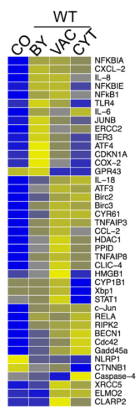
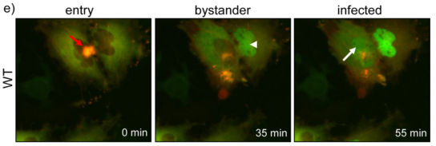
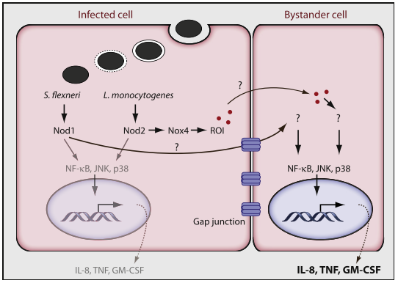
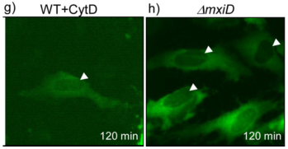
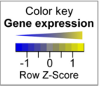
Current research: Identification and characterization of the signaling events that trigger and spread the inflammatory bystander response during bacterial infection of epithelial cells
Signaling Networks: From Data to Modelling
25-29 January 2016, Norwich, UK
Bystander response proposed mechanism:
S. flexneri
Shigella flexneri infection of YFP-p65 HeLa cells
Type III Secretion System mutant
✖️
Invasion
Injection of bacterial effectors
✖️
Hardt WD. 2010
No actin re-modelling
✖️
Invasion
Injection of bacterial effectors
✔️
Lippmann et al. 2015

Slide 25
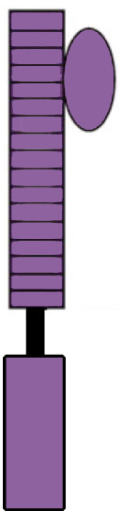
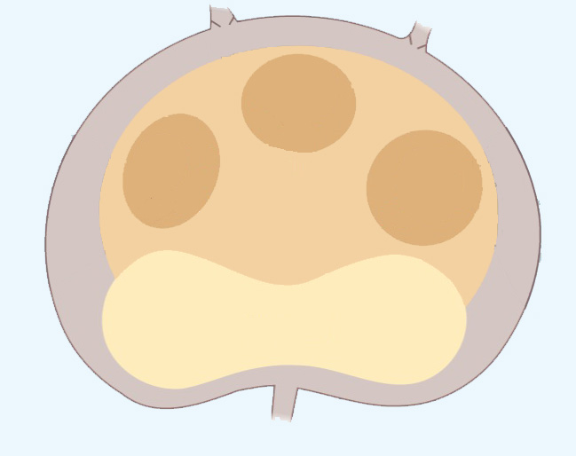
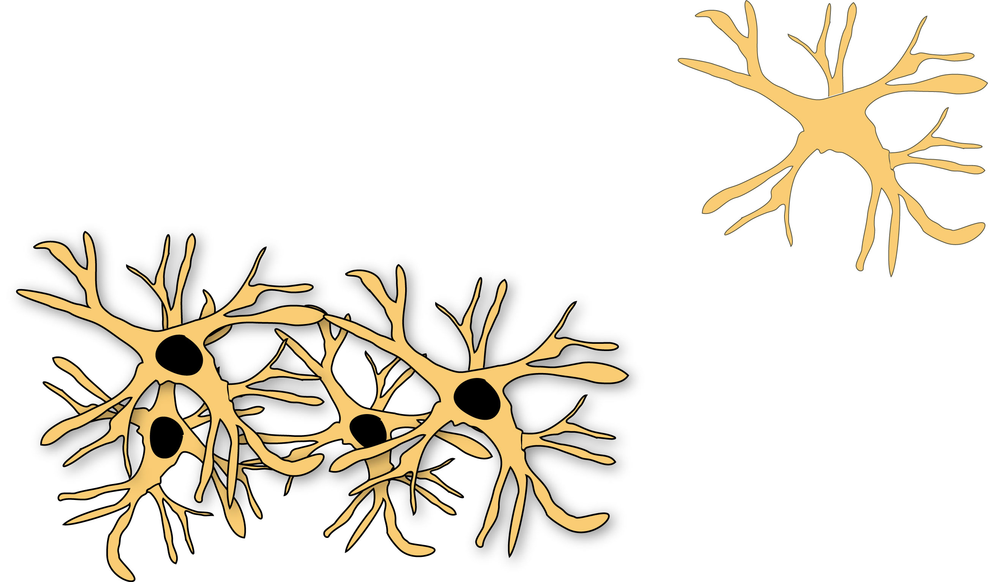
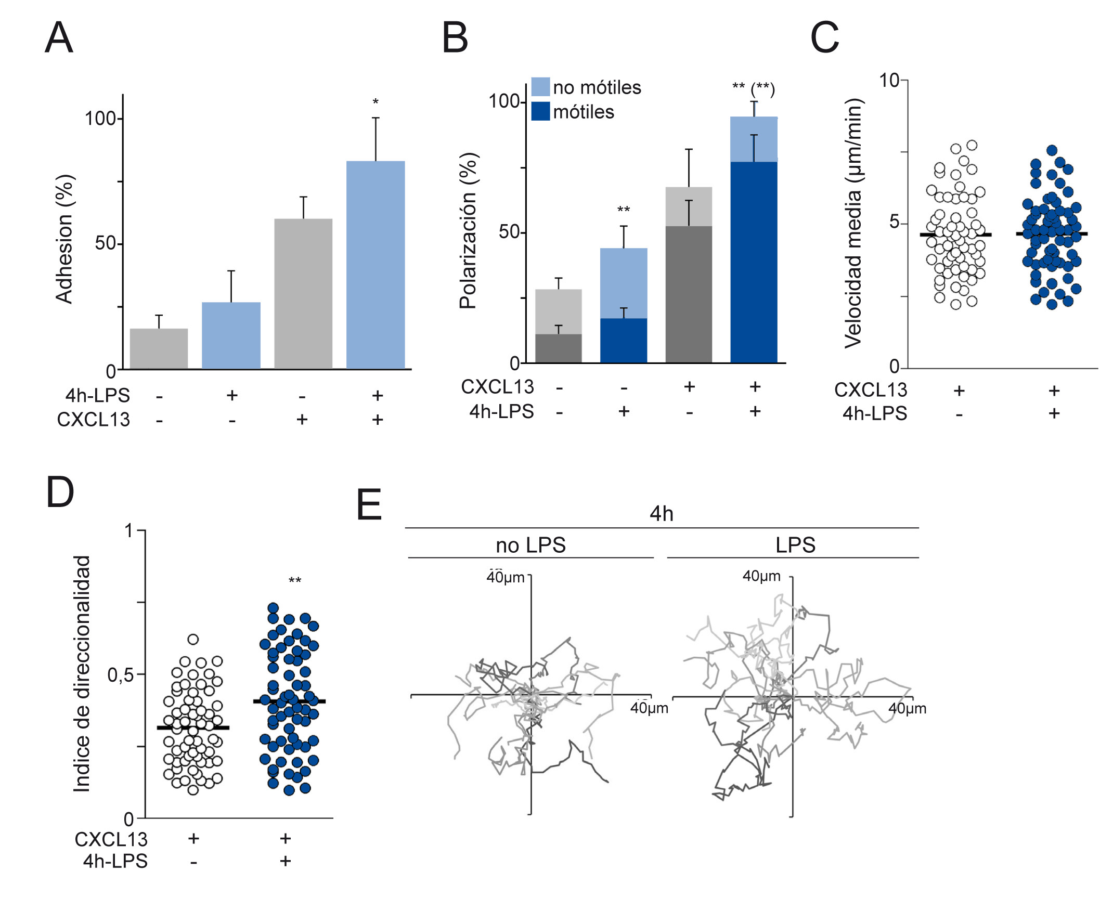
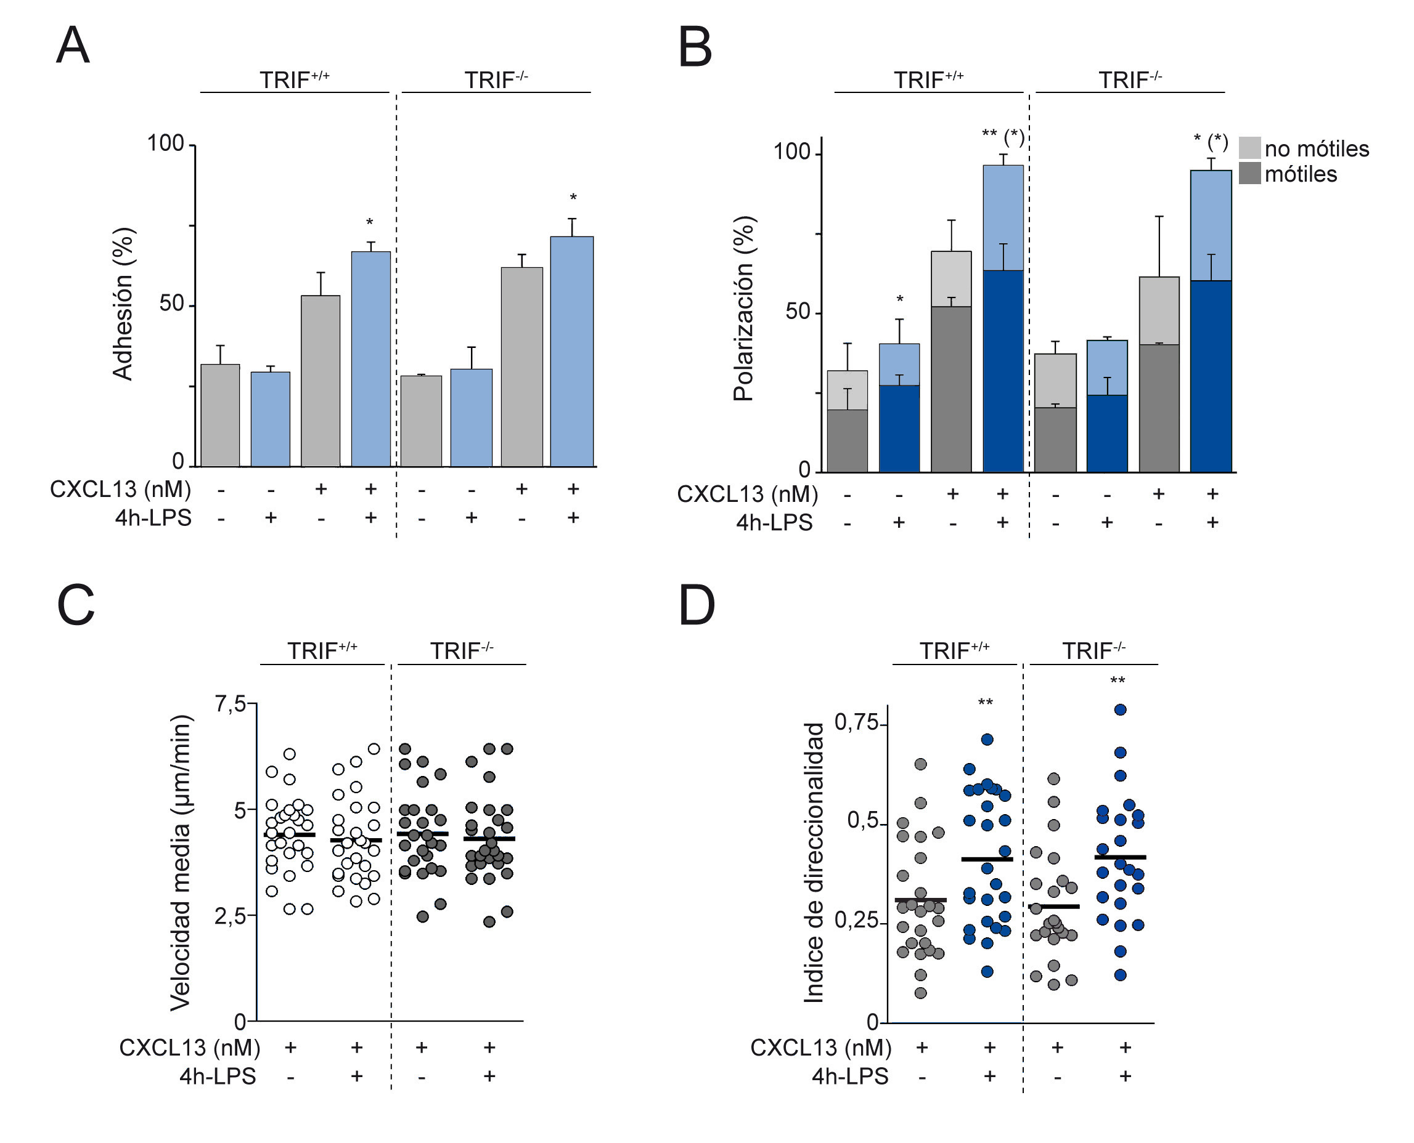
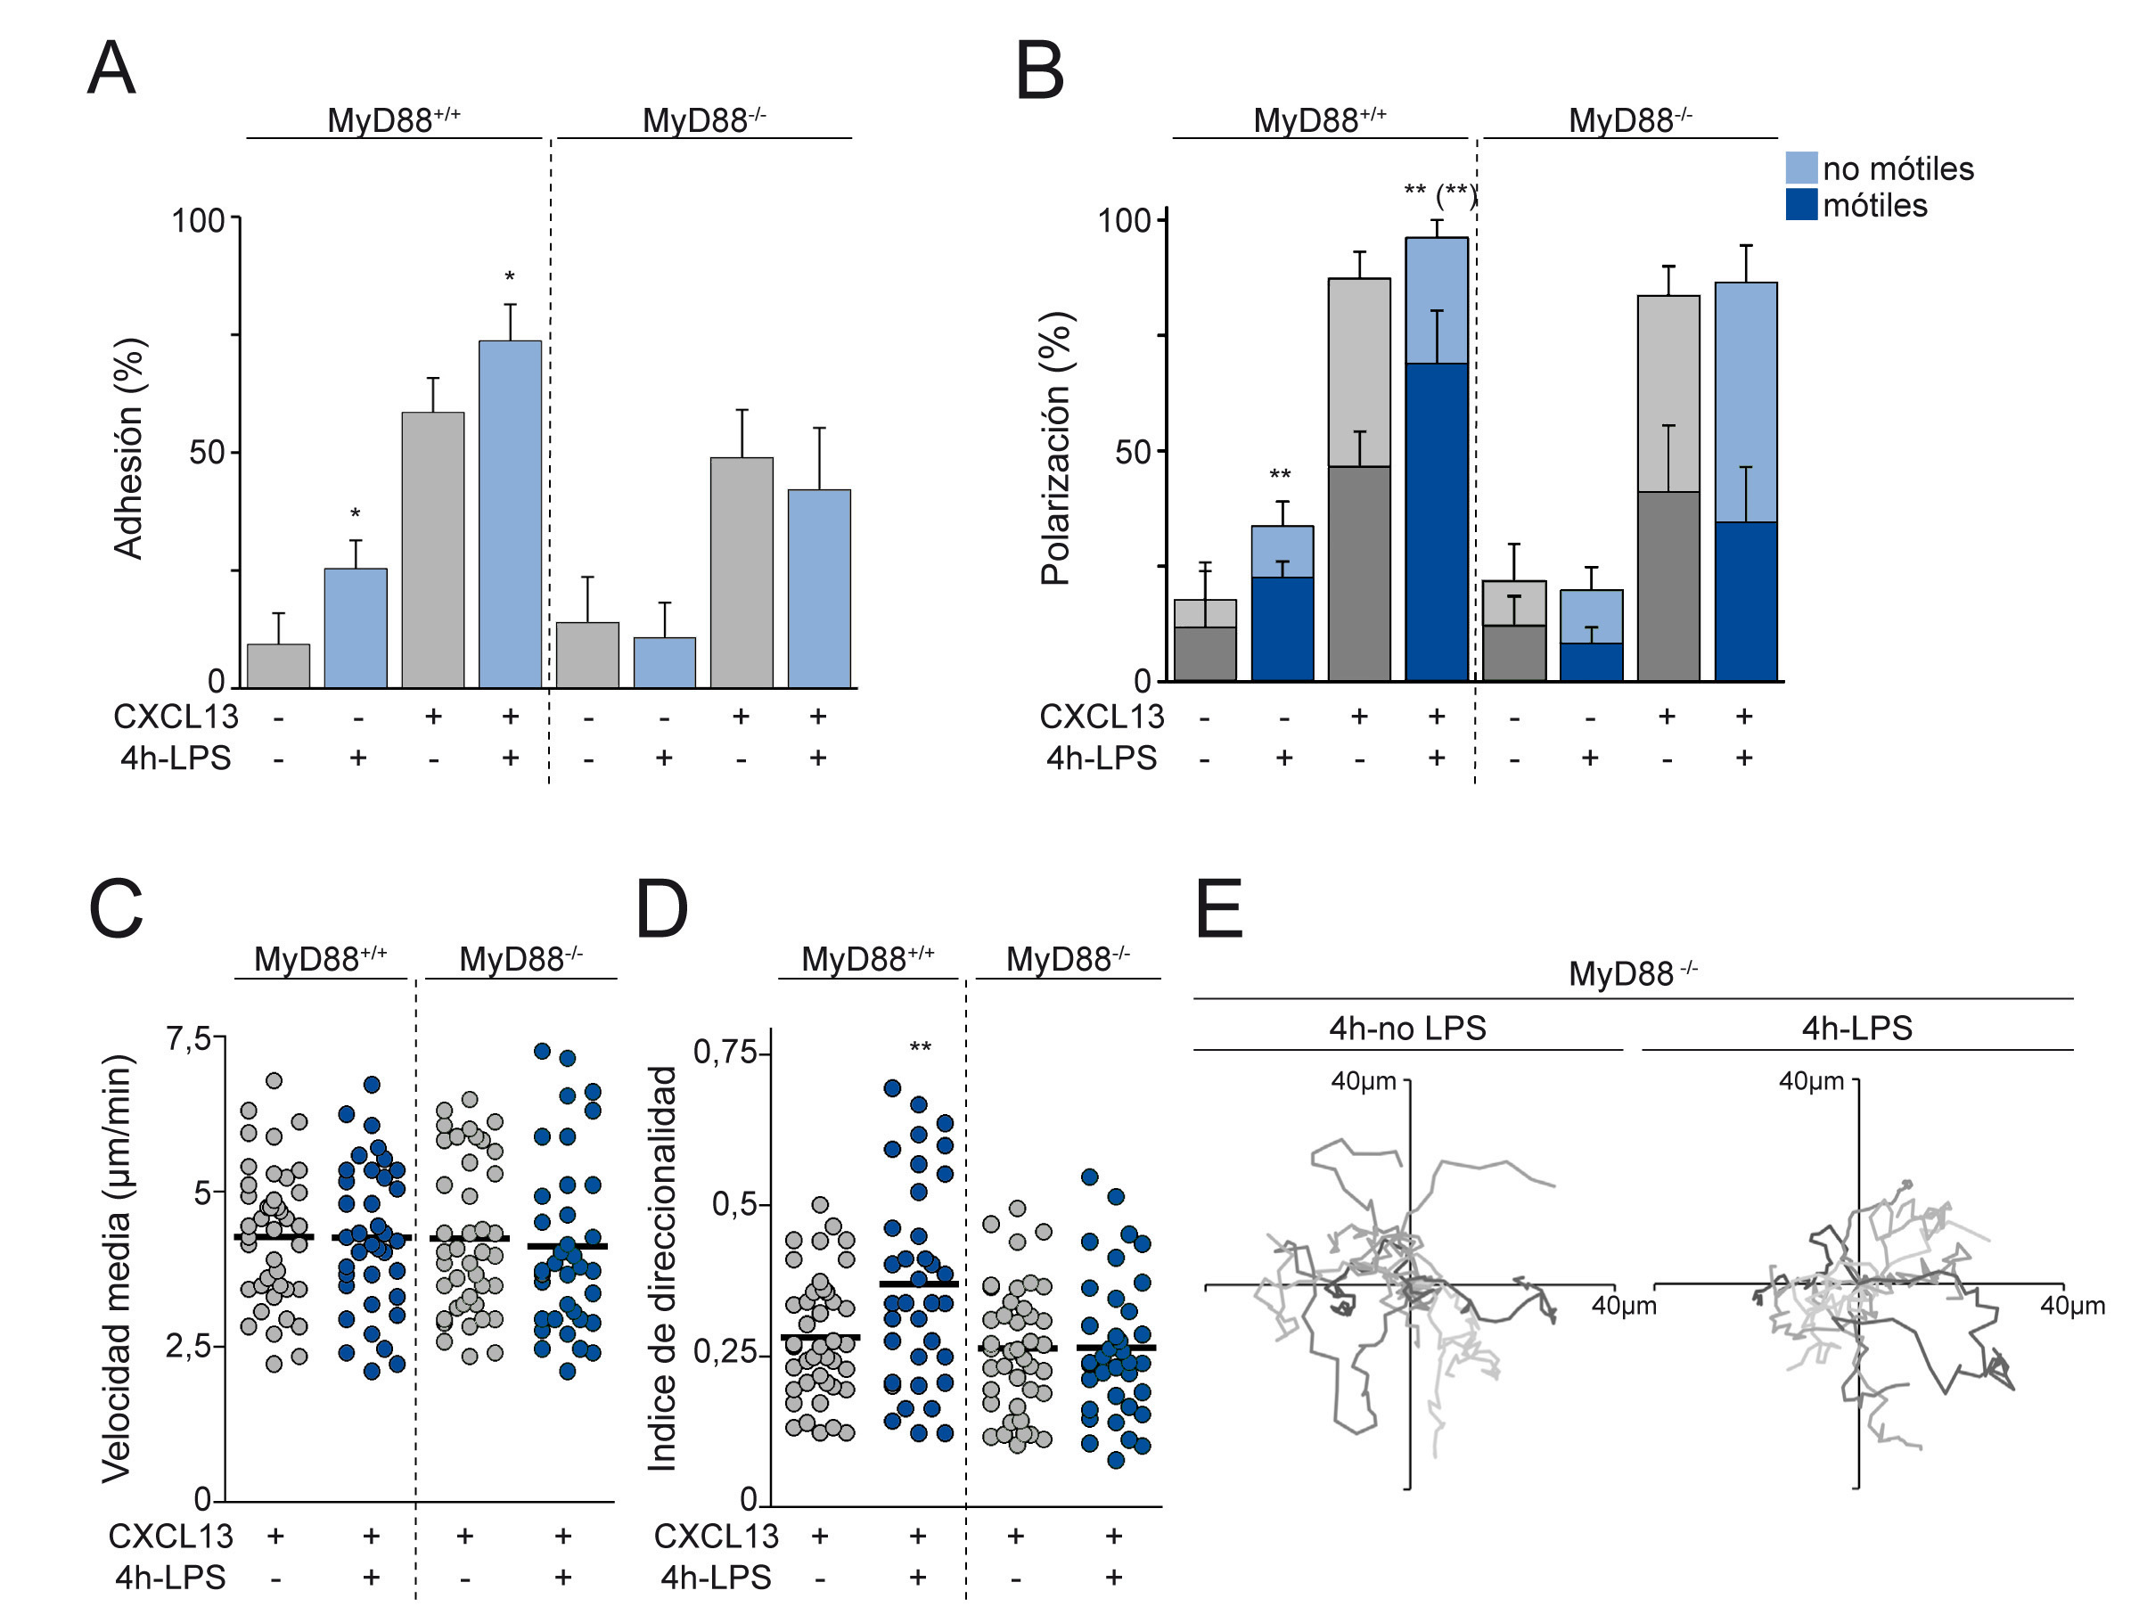
Previous research: Regulation of B cell dynamics by innate stimuli: effects of TLR4 and its ligand LPS
Signaling Networks: From Data to Modelling
25-29 January 2016, Norwich, UK
MD2
MD2
TLR
Follicle
TLR4
CXCL13
BCR
B cell
TRIF
FDC
MyD88
ERK
p38
? PI3K
TLR: Toll-like receptors
? Syk
Rac
non-motile
motile
F-actin
- LPS
Polarization (%)
Straightness index
non-motile
motile
+ LPS
Protrusion/Polarization
Migration
LPS/TLR4-mediated increase in directionality might aid B cells to find targets
Directionality

Slide 26
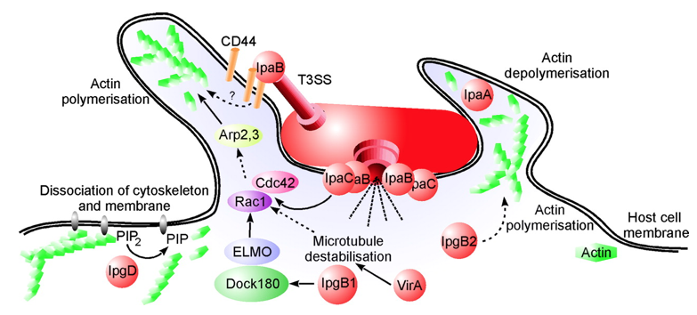
Signaling Networks: From Data to Modelling
25-29 January 2016, Norwich, UK
Why I’m here: Identification and characterization of the signaling events that trigger and spread the inflammatory bystander response during bacterial infection of epithelial cells
NFκB is implicated in cell homeostasis and survival, proliferation, inflammation → signaling pathway is highly complex
Actin cytoskeleton rearrangements
Bacteria containing vacuole formation/rupture
?
Cell-cell adhesions stability
Schroeder and Hilbi. 2008
?
PRR
?
“What will I Learn?
In this course you will learn how to use Cytoscape, where to find the most reliable signaling data, how to reconstruct, analyze and visualize a network.”
http://www.tgac.ac.uk/361_Division/training-programme/courses-workshops/tgac-events/signalling-networks-from-data-to-modelling/
NFκB
NFκB
?
NFκB
NFκB

Slide 27
MEng. Witold Bauer bioinformatician Centre for Bioinformatics and Advanced Data Analysis, Medical University of Bialystok, Poland

Slide 28
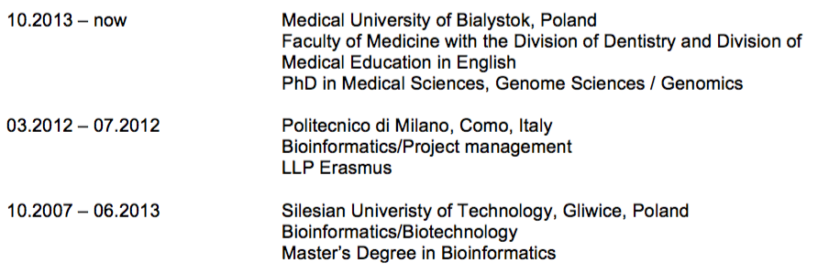
Education

Slide 29
My current research
PhD thesis:
MicroRNA profiling and DNA methylation in relation to cardiovascular outcomes in patients with and without type 2 diabetes.
Type II Diabetes and Obesity genetics:
Genotyping
Exome sequencing
Whole genome sequencing
MicroRNA
Case-control studies in patients suffering T2DM/obesity:
Genomics & phenotype data (body mass, diet, physical activity etc.)
Metabolomics
Proteomics
both as a bioinformatician and statistician

Slide 30
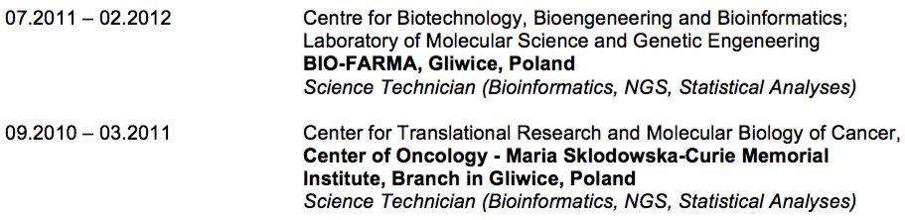
Previous research
Co-author of…
CE-MS-based serum fingerprinting to track evolution of type 2 diabetes mellitus. Electrophoresis, 2015
The rs340874 PROXI type 2 diabetes mellitus risk variant is associated with visceral fat accumulation and alterations in postprandial glucose and lipid metabolism. Genes and Nutrition, 2015
Potential first trimester metabolomic biomarkers of abnormal birth weight in healthy pregnancies. Prenatal Diagnosis, 2014
Decreased expression of thyroglobulin and sodium iodide symporter genes in Hashimoto's thyroiditis. International Journal of Endocrinology, 2014

Slide 31
Why I’m here
Since we are moving from:
Genomics
Metabolomics
Proteomics
To “multi-omics” analyses.
Goal: developing and applying non-hypothesis driven data mining and machine learning approaches to study obesity and type 2 diabetes (T2DM) using existing genetic, (…), immunological, dietary, virological and chemical data.
New datasets require new approches/techniques.

Slide 32

Richard Borne 2nd Year PhD Student

Slide 33

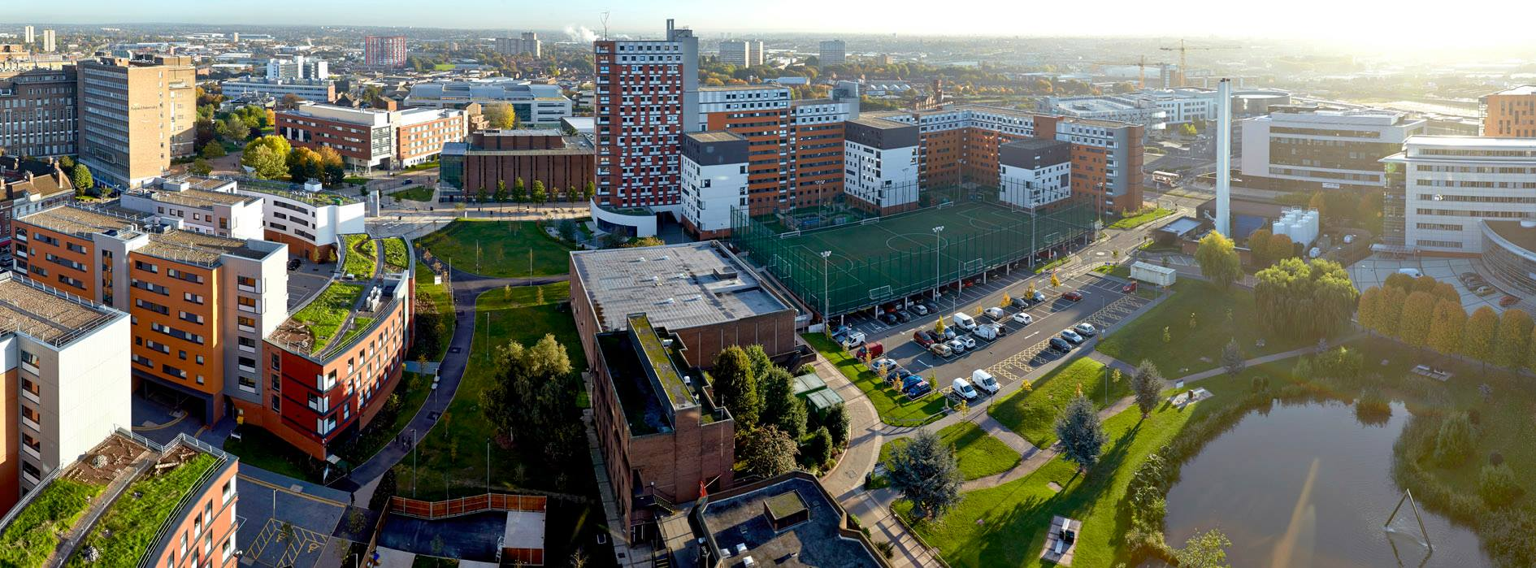

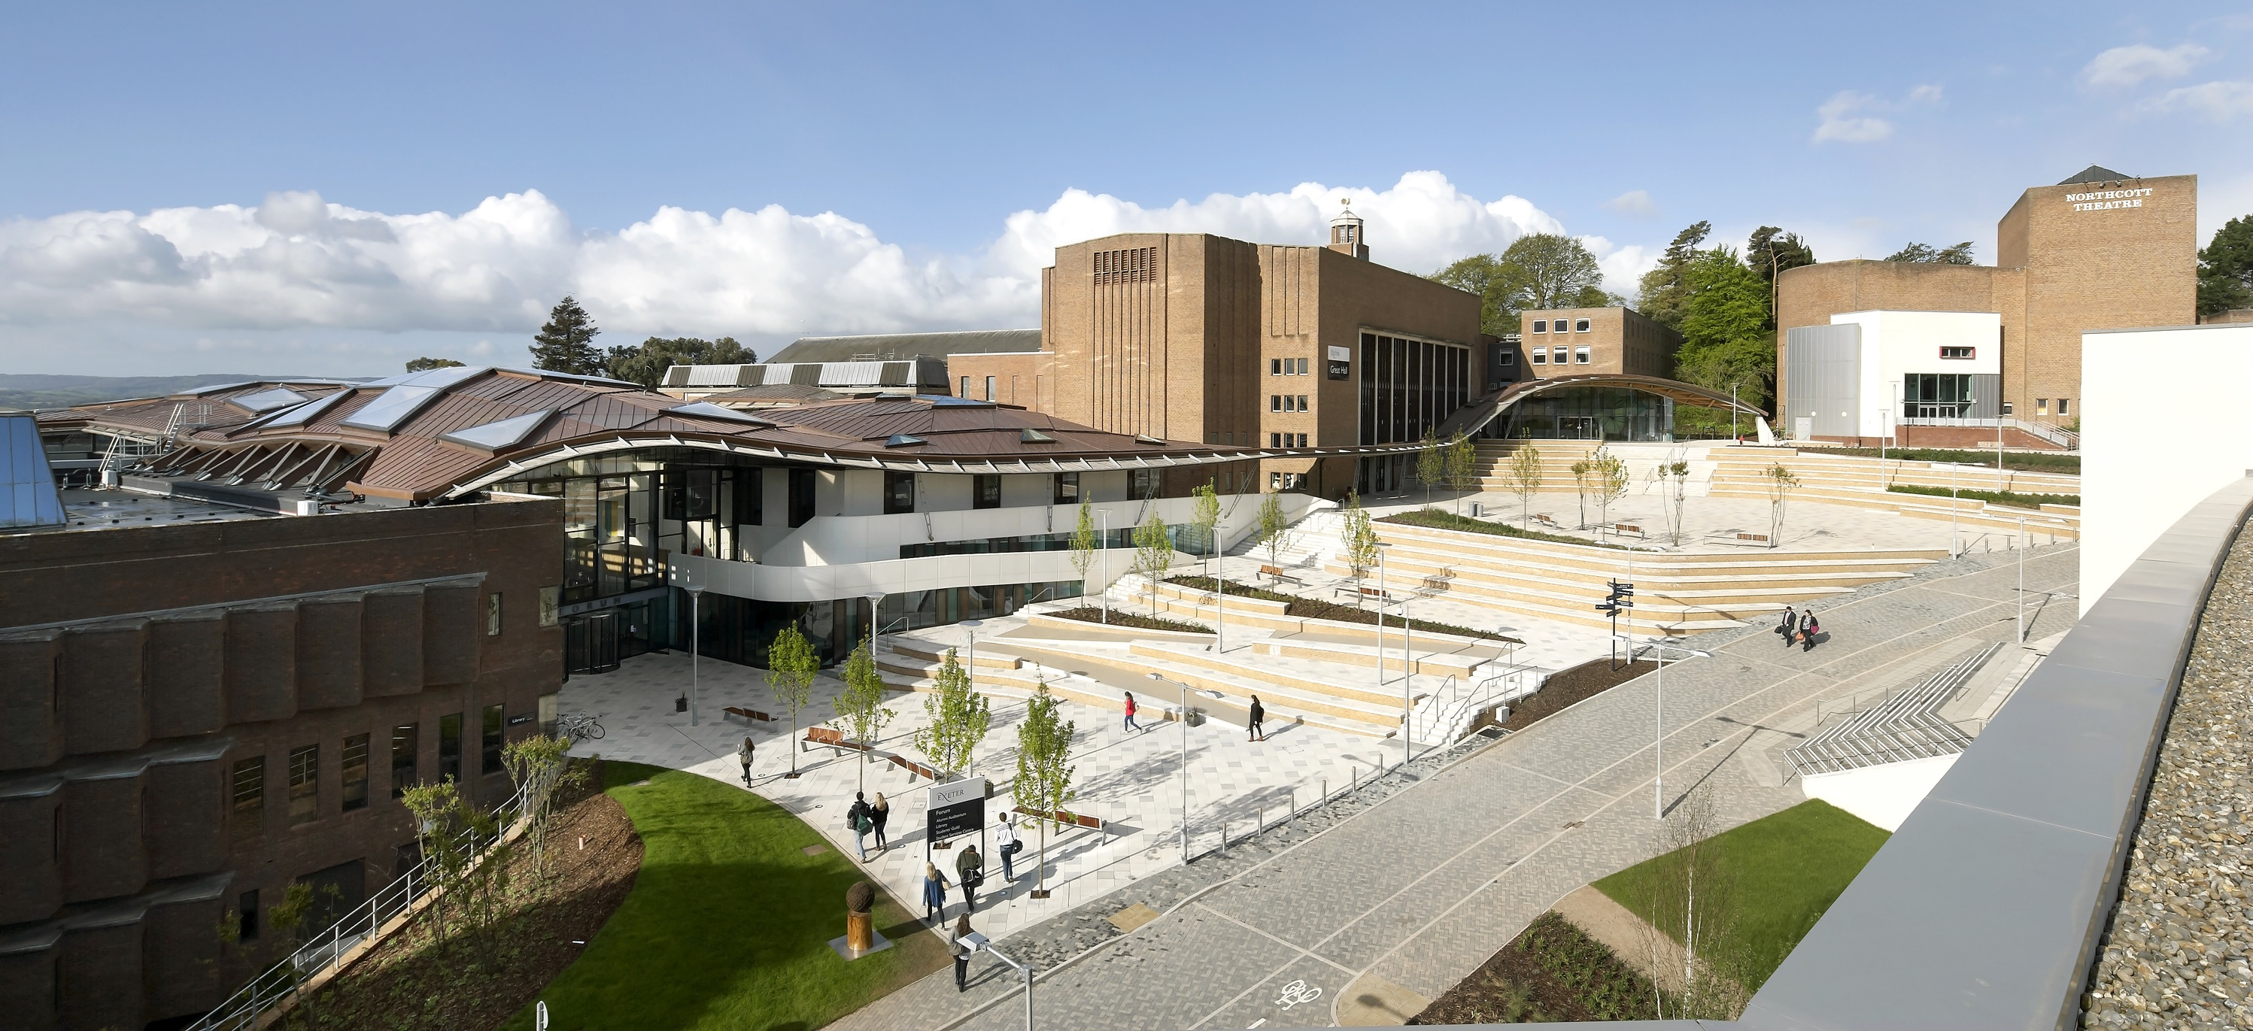
Education
BSc (Hons) – Infection and Immunity
Masters by Research – Molecular Microbiology

Slide 34

My current research
NK cells possess a diverse receptor repertoire that differs between individual NK cells as well as between animals of a herd
NK cell receptor repertoire differences result in different responses to immune challenge
Currently unknown how NK cells acquire their receptor repertoire

Slide 35
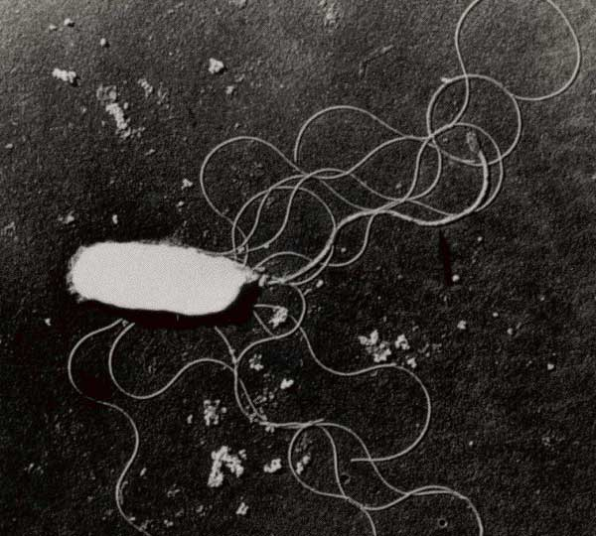
Previous research
Vibrio parahaemolyticus is major cause of foodborne illness worldwide
Recent emergence of clinical strains lacking classical virulence factors
Sequenced 8 strains in order to look for novel virulence factors

Slide 36
Why I’m here
Learn how to apply signalling models to cattle NK cell receptors.
Use signalling models to help understand differential expression data.

Slide 37

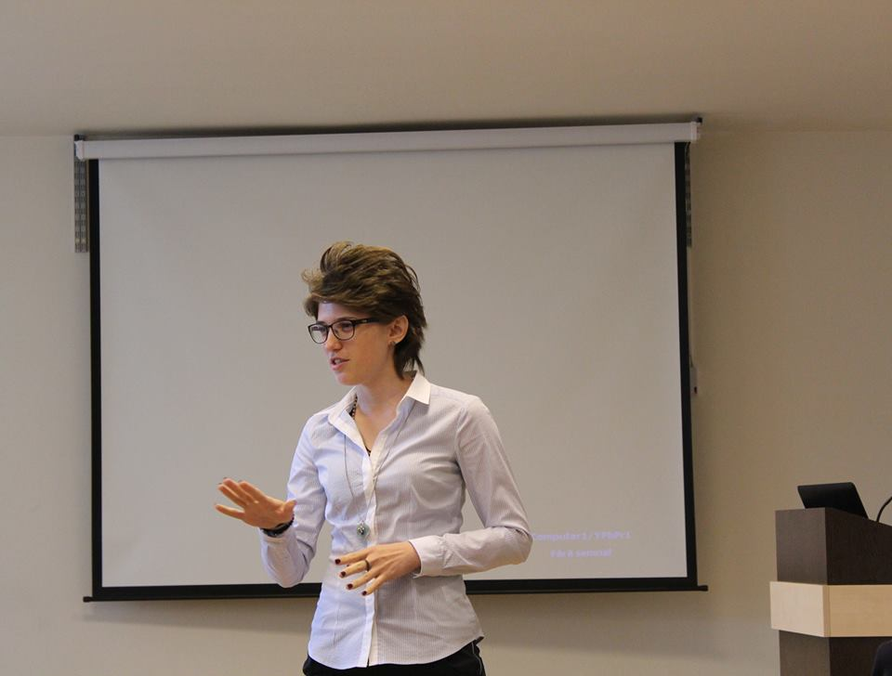
Education
Previous research
Why?
Current research
Petronela Buiga
PhD student – Cell and Cancer Biology
Faculty of Life Sciences / University of Manchester

Slide 38


1. BSc. in Economics / Management (graduated in 2013)
Education
ranked the 1st place among all Dental Schools in Romania
3. BDS (graduated in September 2015)
First class 96%
Scholarships: Fully funded scholarship (tuition fees for 6 years undergraduate studies) Academic Achievements Scholarship (3 years) Scientific Achievements Scholarship (3 years) Erasmus Scholarship, University of Strasbourg, France (5 months), University of Leeds, UK (3 months)
EDSA Scholarship, King’s College London, UK (2 months)
2. MBA (graduated in July 2015)
Home

Slide 39
Current research
Systems Biology regulation of MAPK pathways:
applications to cancer therapy
Aim:
To undertake an integrated systems biology approach to understand how inhibition of MAPK signalling kinases and phosphatases will impact on the efficacy of HER2-positive breast cancer treatments and guide future efforts in the design of more efficient and personalised cancer therapies.
Significance:
This study will lead to true understanding of network dynamics in tumour cells and to development of suitable drug therapy regimens and individualised patient treatments
Home

Slide 40



Previous research
1. Visiting Research Assistant - University of Leeds, UK (3 months)
A comparison of the stability of functionalized chitosan hydrogels during hydrolytic or enzymatic degradation
2. Research Training Program - IGBMC, Strasbourg, France (4 months)
Study of the genes expression involved in teeth development: The involvement of a new TGFβ pathway gene in rare diseases
3. Summer Research Program - University of Oxford, UK (2 months)
Ovarian Cancer
4. Summer Research Program - King’s College London, UK (2 months)
Upper airway anomalies- Developmental aspects of the trachea
5. Grant 2000 Euros – University of Medicine and Pharmacy Cluj-Napoca, Romania (2 years)
Evaluation of the relationship between microbial fingerprint and some risk indicators of aggressive periodontitis in young subjects
6. Grant 2000 Euros – University of Medicine and Pharmacy Cluj-Napoca, Romania (1 year)
Rapid identification of sub gingival flora from untreated subjects with localized aggressive periodontitis
Home

Slide 41
Why I’m here
Major part of my project is to investigate MAPK signaling pathways and to design and implement a Boolean model.
Learn about specific tools that I will be using throughout my PhD.
Have a wider knowledge about signaling pathways.
Have proper training on network analysis and reconstruction.
Develop my knowledge to design, build and apply my Boolean model for my research.

Slide 42
Thank You
Home

Slide 43
Isabelle Camu PhD Student John Innes Centre , Crop genetics

Slide 44
Education
Bachelor in Molecular biology
Master degree in Plant physiology
PhD in Plant physiology

Slide 45
My current research
Working on seed germination and seed vigour
Physiology aspect
Biochemistry aspect
Molecular aspect

Slide 46
Previous research
Internship on biocontrol to reduce black rot on Brassica oleracea
University of Lincoln (NZ)
Internship on oligosaccharide production from green algae
CNRS – Station Biologique de Roscoff (FR)
Internship on genetic improvement of wheat’s nutrient
Rothamsted research (UK)
Internship on Arabidopsis thaliana mutant affected in regulation of APR
John Innes centre (UK)
Internship on HIV: phenotypic interaction of NK and DC
Institut Pasteur (FR)
Internship on nitrogen absorption on Brassica napus
INRA (FR)

Slide 47
Why I’m here
To learn how to represent an overview of signalling pathway or network with Cytoscape
To learn how to model my own network from RNAseq data

Slide 48
Matheus H. Dias
Post-doc LECC – LETA/CeTICS Instituto Butantan São Paulo - Brazil

Slide 49
Education
Undergraduation
Biomedical Sciences at Universidade Bandeirante de São Paulo, São Paulo, Brazil
PhD
Biochemistry program of Universidade de São Paulo (USP), São Paulo, Brazil.

Slide 50
My current research
We work on the signaling networks underlying Ras-induced malignant transformation, focusing on a putative functional interaction between Ras and Cyclin D1 to mitigate oncogenic stress and drive tumorigenesis, aiming to uncover specific vulnerabilities inherent of Ras-driven malignant phenotypes.

Slide 51
Previous research
We probed into the molecular mechanisms underlying the toxic effects of Fibroblast Growth Factor 2 in Ras-driven malignant cells. We found that FGF2 triggers G2 arrest, disconnects cell growth from proliferation leading to proteotoxic stress and cell death depending on high constitutive levels of Ras-GTP.

Slide 52
Why I’m here
As an enthusiastic of signaling networks, my goal here is to learn how to properly build my own models and use these models to understand alterations in signaling pathways caused by oncogenic Ras, and thus, uncover potential vulnerabilities inherent of Ras-driven malignant transformation.

Slide 53




Zoltan Dul PhD student King’s College London

Slide 54







Education
2014-
PhD Student
King’s College London
Randall Division of Cell & Molecular Biophysics
London, UK
Research Associate
Fondazione Edmund Mach
Research and Innovation Center
San Michele All’ Adige, Italy
2010-2013
Junor Research Associate
Network Biology (NetBioL) Group
Eotvos Lorand University
Faculty of Science
Budapest, Hungary
2007-2013
Doctor of Dental Science (DDS), MSc
Semmelweis University
Faculty of Dentistry
Budapest, Hungary

Slide 55
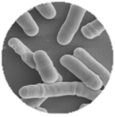
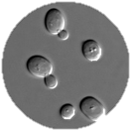
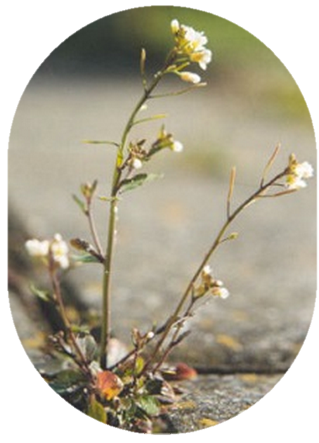
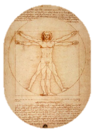
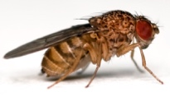
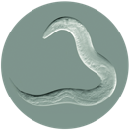
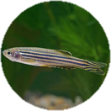



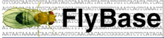
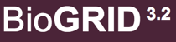


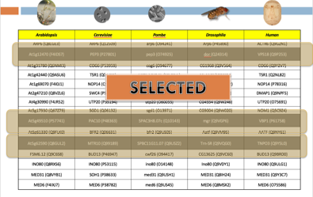


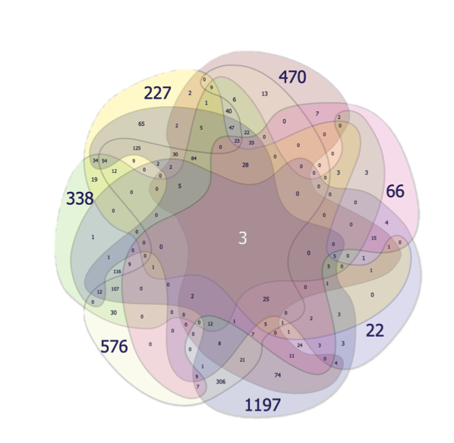
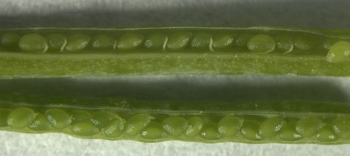
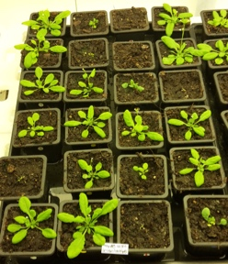


Regulation of cell size based on orthological relation
www.orthologfindertool.com
Hypothesis & Big Idea
Protein functions are kept throughout the phylogenetic tree.
Project’s importance
Wet lab aided computational biology. - Not just theory.
New potential targets & orthology relation.
Data visualization with Venn Diagrams
Testing on
Arabidopsis & Human T-Cells with cell size function
M
M
Collecting spec gene lists (or GO terms).
Adding PPI interactions & network
M
F
F
Using Orthology databases
Adding first neighbour proteins
M
Determine and compare overlapping proteins
Analyse and query specific list of proteins
Predict novel annotation
T
A
In progress
Experimental tests
T
bumping
VBP1_KD
A

Slide 56

Previous research
A manually curated & integrated resource to analyze signaling pathway cross-talks, transcription factors, miRNAs and regulatory enzymes
My participation was the manual curation of the PPI connection in the NHR pathway.
www.signalink.org
(Fazekas et al, BMC Systems Biology, 2013)
Novel cancer associated fibroblast markers
Using experimental and clinical data from tumour associated fibroblasts.
Found novel cancer associated fibroblasts markers based on other cancer related databases.
(Bozoky et al, International Journal of Cancer Research, 2013)
Analysis of Network Motifs
I was analysing the importance of those network motifs, which contains 3 nodes and 3 links in the regulation network of human proteins.
I was found significat connection
(unpublished)

Slide 57


Why I’m here
Cytoscape
Data Science
Data Modelling

Slide 58

Tyler McCleery Post-Doc John Innes Centre

Slide 59

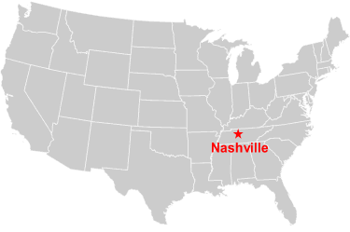
Education
Ph.D. in Physics

Slide 60

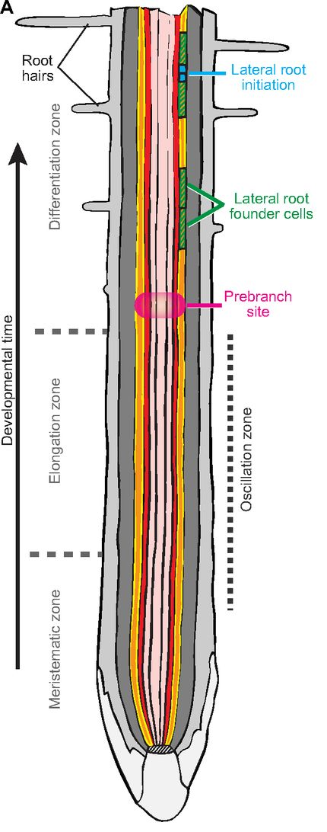
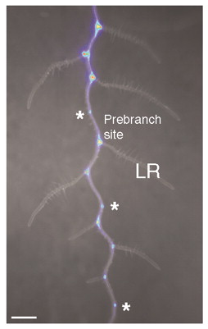
My current research
How does Nitrate affect Lateral Root Initiation?
NO₃⁻
Oscillating
Genes
Van Norman, J. M. et al (2013). Development, 140: 4301-4310.
Moreno-Risueno, M. A. et al (2010). Science, 329: 1306–1311.

Slide 61


Previous research
Amnioserosa
Germ Band
Pulling Through:
A Biomechanical Analysis of
Normal and Aberrant Embryogenesis in Drosophila

Slide 62
Why I’m here
How to identify genes of interest from experimental results?
What experiments can test the dynamics of a hypothetical GRN?
How to create a model that informs experiments?

Slide 63
Dr. Frank Menke Head of Proteomics the Sainsbury Laboratory

Slide 64
Education and previous positions
PhD in Plant Molecular Biology from Leiden University (the Netherlands)
Postdoc in lab of Dan Klessig (HFSP fellow at Boyce Thompson Institute,
Cornell University, USA)
Postdoc Phytopathology (HFSP fellow) Utrecht University (the Netherlands)
Assistant professor Molecular Genetics at Utrecht University (the Netherlands)

Slide 65
My current research
H⁺
flg22
O₂
O₂⁻
FLS2
RBOHD
BAK1
RIN4
P
BIK1
P
P
P
PBL1
P
P
P
P
H⁺
Ca²⁺
CDPK
MPKKKK
P
P
RAF
MPKKK
MPKKK7
RAF
P
P
P
P
P
MKK4
MKK5
MKK1
MKK2
P
P
P
P
P
P
P
P
P
MPK16
MPK17
MPK9
MPK6
MPK3
MPK4/11
MPK13
MPK8/15
Benschop et al. (2007) Mol Cel Proteomics; Mithoe et al. (2012) J of Prot Res

Slide 66
Why I’m here
Learn more about tools for analysis and modeling of signaling networks

Slide 67
Dr. Sharon Mithoe Research Scientist Proteomics IFR extra/IFR

Slide 68
Education
BSC in Delft, The Netherlands
PhD in Delft, The Netherlands
Postdoc at Cell and Developmental Biology (JIC)

Slide 69
My current research
I work with research leaders, currently Dr. Paul Kroon and advise on the most
appropriate approach to unravel signaling pathways.
I am currently working on a project which focuses on post-translational modifications
in angiogenesis.
Previous research
pTyr phosphorylation in plants
MAP kinase kinase kinase which functions as a negative regulator of pattern recognition receptor signaling and immunity.

Slide 70
Why I’m here
I would like to learn more about signaling networks and the tools which
are available for visualization of protein networks

Slide 71
Nawin N Mohammed Visiter PhD Student at The University of Buckingham

Slide 72
Education bachelor and MSc degree in Statistic and computer science at university of Sulaymānīyah\kurdistan And Now PhD student.

Slide 73
My current research Iam working on computational biological pathway.

Slide 74
Previous research I start my research with Gene expression analyses for obese and lean individuel

Slide 75
Why I’m here To learn about The biological pathways and how to analyse them .

Slide 76
Pirasteh Pahlavan PhD student, Bioinformatics

Slide 77
Education
BSc of plant protection
MSc of Agricultural Biotechnology

Slide 78
My current research
Plant-virus interaction in transcriptome level:
Nicotiana benthamiana interacting with a DNA virus (ACMV) and a RNA virus (CBSV)

Slide 79
Previous research
Application of Post Transcriptional Gene Silencing (PTGS) to control cucumber mosaic virus (CMV)

Slide 80
Why I’m here
Learning the most reliable method to compare the networks
Learning how to make a model based on the network
Learning how to decide what is the best model

Slide 81
Dr. Željko D. Popović, Assistant professor University of Novi Sad, Faculty of Scieces, Novi Sad, Serbia Laboratory of Biochemistry and Molecular Biology

Slide 82
Education
2014 | Ph.D. in Molecular Biology | University of Belgrade, Faculty of Biology, Serbia
2007 | M.Sc. in Functional Biology | University of Novi Sad, Faculty of Sciences, Serbia
2006 | B.Sc. in General Biology (majors in Animal Physiology) | University of Novi Sad, Faculty of Sciences, Serbia
2002 | Grammar School (Gymnasium) | Zrenjanin
Study visists abroad
2014-2015 | Eötvös Loránd University, Budapest, Hungary Visegrad Scholarship | Work on dormancybase Supervisor Dr. Eszter Ari, ELTE
2010-2011 | Biology Centre of the Czech Academy of Science, Institute of Entomology Visegrad Scholarship | Work on diapause in european corn borer Supervisor Prof. Dr. Vladimir Košta’l
2008 | British Antarctic Survey Antarctic Genomic Laboratory 6-month specialisation | Work on cryoprotective dehydration, supervisor Dr. Melody Clark
2005 | DAAD scholar | DID Berlin Botanic Garden Berlin

Slide 83






Current research
DORMANCYbase – developing a database on gene and protein expression during dormancy in animals (dormancy.org)
Biochemical and molecular processes governing animal dormancies and tolerance to extreme environments:
Gene expression
Enzyme activity
Metabolomics

Slide 84
Previous research
Aquatic toxicology and hydrobiology, mainly during my BSc studies and Grammar school

Slide 85
Why I’m here
To become more familiar with resources and tools related to signalling pathways and networks as well as with basics of modelling of signaling events.
To explore potential to use data from dormancybase to model signaling pathways and networks in animal dormancies

Slide 86
Alberto Santos Delgado PhD student The Novo Nordisk Center for Protein Research

Slide 87
Education
MSc in Bioinformatics for Health Sciences
Universitat Pompeu Fabra
Barcelona (Spain)
Computer Engineering
Universidad Politécnica de Valencia
Valencia (Spain)

Slide 88

My current research
Focus on
Cellular network biology
Analysis and interpretation of high-throughput data
Identification of relevant phosphorylation-dependent signaling

Slide 89



Previous research
Cyclebase.org a database on cell-cycle regulation and phenotypes
http://cyclebase.org/
TISSUES a resource of gene–tissue associations
http://tissues.jensenlab.org/
IntOGen-mutations platform which summarizes somatic mutations, genes and pathways involved in tumorigenesis
http://www.intogen.org/

Slide 90
Why I’m here
Perfect match between the course program and the requirements of my current project:
Modeling the dynamics of the signaling network activated in response to mitosis-targeted anti-cancer therapies
I need the skills to analyze, visualize and model this complex system

Slide 91
Fei-Yian Yoong Post-Doc Crop Genetics Department

Slide 92
Education
University of California Davis:
- Bachelor’s degree in Plant Biotechnology with a minor in Geology
- PhD in Plant Biology with a designated emphasis in Biotechnology

Slide 93
My current research
Improving Brassica seed vigor and resilience using genetics, transcriptomics, and seed physiology. I am trying to investigate the mechanism underlying the regulation of seed vigor and seedling establishment in Brassica species. I am particularly interested in determining the role of maternal effect on seed coat properties which may regulate Brassica seed vigour.

Slide 94
Previous research
I was involved in improving lettuce seed germination during high temperature imbibition. Using genetics, molecular biology, transcriptomics, and seed physiology, I was looking for alleles that improve germination at high temperatures. With the identification of the allele, I was able to enhance our understanding of seed biology pertaining high temperature in conjunction with hormonal regulation. I was able to initiate the early work of introgressing this allele of interest into the desired genetic background to improve lettuce germination under warm condition.

Slide 95
Why I’m here
I am here at the workshop because I am currently using transcriptomic data (RNA-seq) to investigate genes that are expressed in Brassica seeds during development. I’d like to utilize my transcriptomic data, along with currently available Brassica seed transcriptomic data, to perform some gene regulatory network (GRN) to better understand interactions of my genes of interest with other genes. The GRN will also assist me to select some potential genes for Targeting Induced Local Lesions in Genomes (TILLING) pipeline to breed for Brassica with improved seed viogor. Also, by deleting the function of these selected genes using TILLING, I can investigate their roles in regulating seed vigor and germination, especially related to maternal effect.

